Slide 1

Pollution Data websites
AERONET, GIOVANNI, MODIS, MERRA2, NASA FIRE, EUMETSAT, CAMS Reanalysis and Forecast
Dr. Zeinab Salah Mahmoud
Egyptian Meteorological Authority

Slide 2
AERONET (AErosol RObotic NETwork)
It is a federation of ground-based remote sensing aerosol networks established by NASA and PHOTONS (PHOtométrie pour le Traitement Opérationnel de Normalisation Satellitaire; Univ. of Lille 1, CNES, and CNRS-INSU) and is greatly expanded by networks, calibration centers, and collaborators.
For more than 25 years, the project has provided long-term, continuous, and readily accessible public domain database of aerosol optical, microphysical and radiative properties for aerosol research and characterization, validation of satellite retrievals, and synergism with other databases.
AERONET collaboration provides globally distributed observations of spectral aerosol optical Depth (AOD), inversion products, and precipitable water in diverse aerosol regimes. Aerosol optical depth data are computed for three data quality levels: Level 1.0 (unscreened), Level 1.5 (cloud-screened), and Level 2.0 (cloud screened and quality-assured). Inversions, precipitable water, and other AOD-dependent products are derived from these levels and may implement additional quality checks.
https://aeronet.gsfc.nasa.gov/new_web/index.html
https://aeronet.gsfc.nasa.gov/new_web/draw_map_display_aod_v3.html?level=2

Slide 3
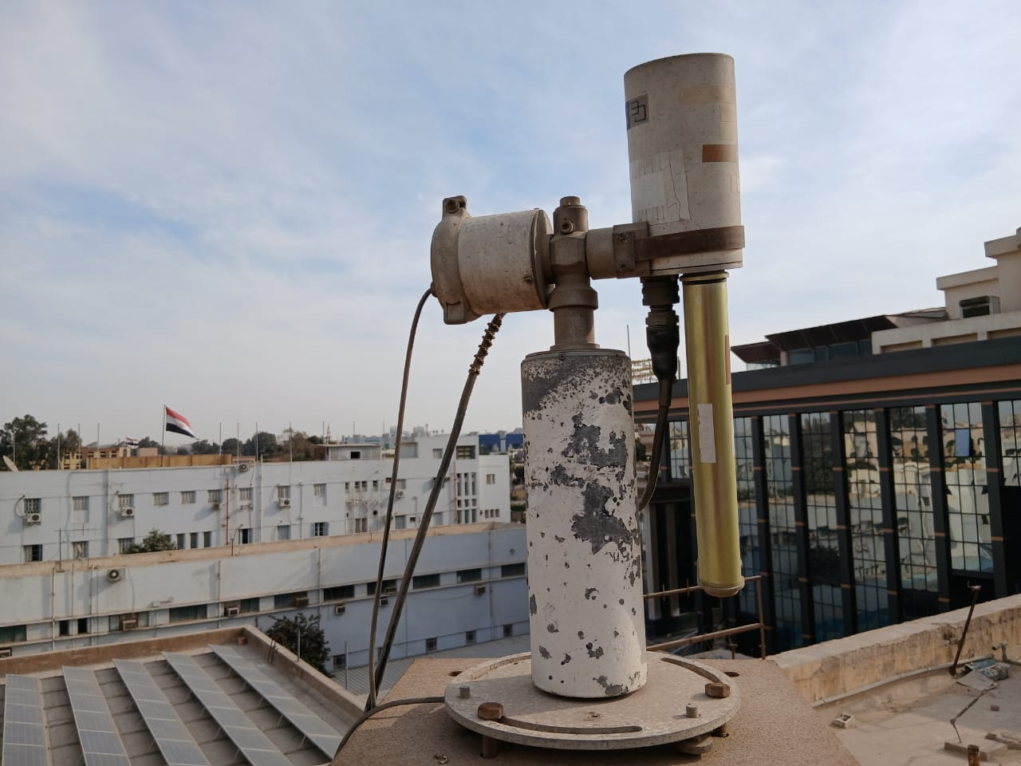
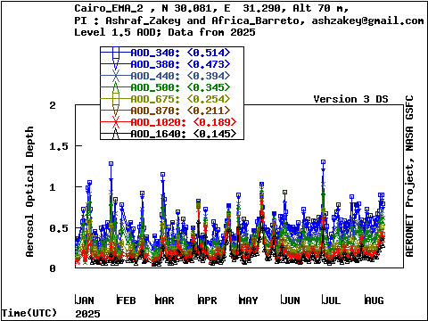
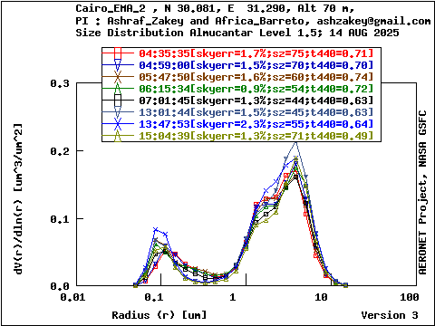
Sunphotometer in Cairo
AOD Level 1.5 data from year of 2025
Almucantar Level 1.5 data from 14 Aug 2025
https://aeronet.gsfc.nasa.gov/new_web/photo_db_v5/Cairo_EMA_2.html
https://aeronet.gsfc.nasa.gov/cgi-bin/data_display_aod_v3?site=Cairo_EMA_2&nachal=2&level=2&place_code=10
Download Data: https://aeronet.gsfc.nasa.gov/cgi-bin/webtool_inv_v3?stage=3&region=Northern_Africa&state=Egypt&site=Cairo_EMA_2&place_code=10&if_polarized=0

Slide 4
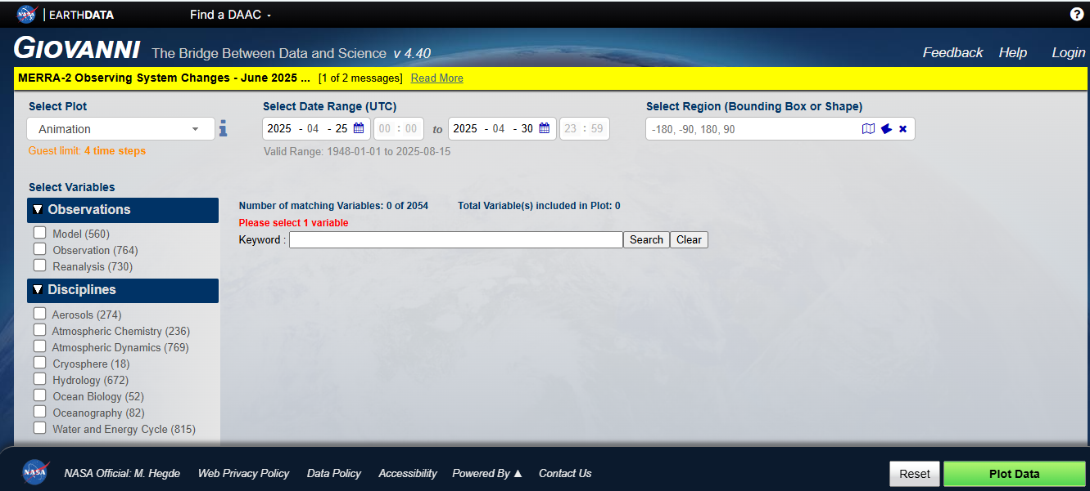
Giovanni Satellite Data
Displaying way
The dates
Select your area or take the global
Type of data
Select the variables you want
Click to plot your variable
https://giovanni.gsfc.nasa.gov/giovanni/

Slide 5
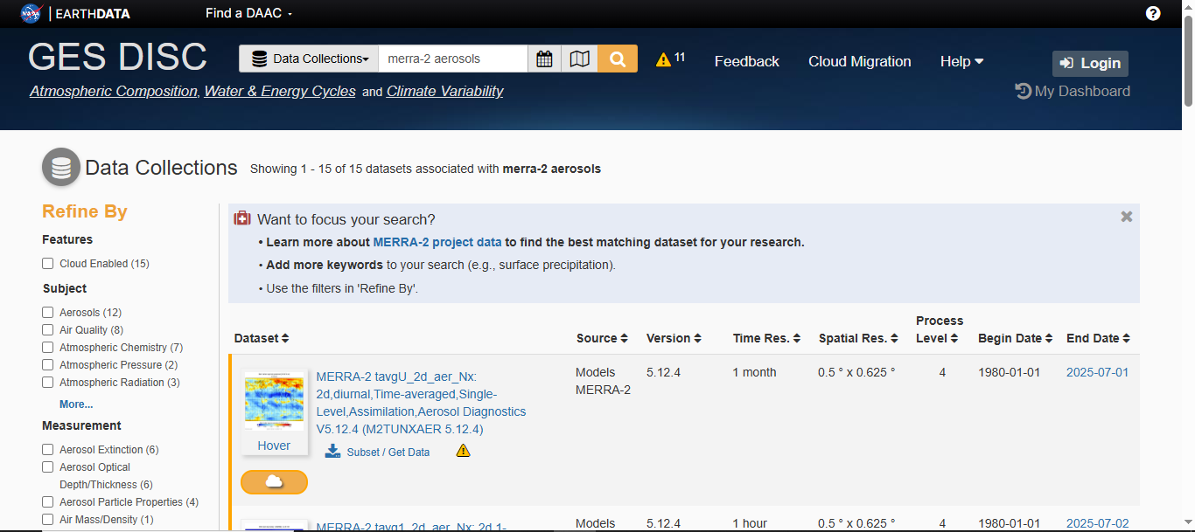
MERRA2 Reanalysis Data
MERRA-2 is the latest version of global atmospheric reanalysis for the satellite era produced by NASA Global Modeling and Assimilation Office (GMAO) using the Goddard Earth Observing System Model (GEOS) version 5.12.4. The dataset covers the period of 1980-present with the latency of ~3 weeks after the end of a month.
https://disc.gsfc.nasa.gov/datasets?keywords=merra-2%20aerosols&page=1

Slide 6
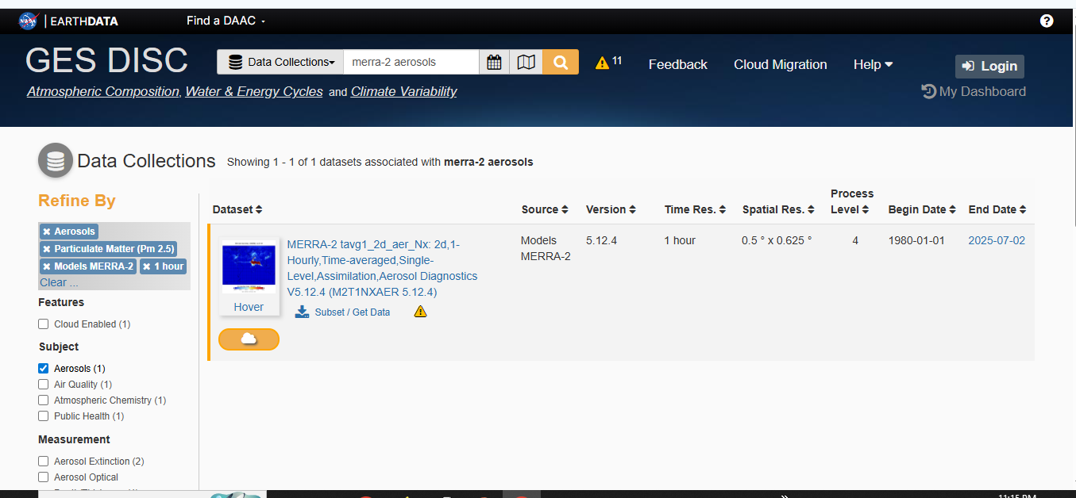
PM2.5 from MERRA2
It is an hourly time-averaged 2-dimensional data collection in Modern-Era Retrospective analysis for Research and Applications version 2 (MERRA-2).
This collection consists of assimilated aerosol diagnostics, such as column mass density of aerosol components (black carbon, dust, sea salt, sulfate, and organic carbon), surface mass concentration of aerosol components, and total extinction (and scattering ) aerosol optical thickness (AOT) at 550 nm.
The total PM1.0, PM2.5, and PM10 may be derived with the formula described in the FAQs under the Documentation tab of this page. The data field is time-stamped with the central time of an hour starting from 00:30 UTC, e.g.: 00:30, 01:30, … , 23:30 UTC.
https://disc.gsfc.nasa.gov/datasets?keywords=merra-2%20aerosols&page=1&subject=Aerosols&measurement=Particulate%20Matter%20(Pm%202.5)&source=Models%20MERRA-2&temporalResolution=1%20hour

Slide 7
PM2.5 from MERRA2
To calculate PM2.5 from MERRA2, you should download all components of PM2.5 and calculate this equation:
PM2.5 (µg/m3) = (DUSMASS25 + OCSMASS+ BCSMASS + SSSMASS25 + SO4SMASS*1.375) *1.e9
Where:
  DUSMASS25 = dust mass concentrations (particles with size < 2.5 micro meter)
  OCSMASS= organic carbon mass concentration
  BCSMASS= black carbon mass concentration
  SSSMASS25= Sea Salt mass concentration (particles with size < 2.5 micro meter)
  SO4SMASS = Sulfate mass concentration
  The factor of 1.375 (=132.14/96.06) is applied to convert sulfate ion (molar mass of 96.06 g mol-1) concentration output by MERRA-2 to ammonium sulfate (132.14 g mol-1) assuming that sulfate is primarily present as neutralized ammonium sulfate.
https://forum.earthdata.nasa.gov/viewtopic.php?t=4287

Slide 8
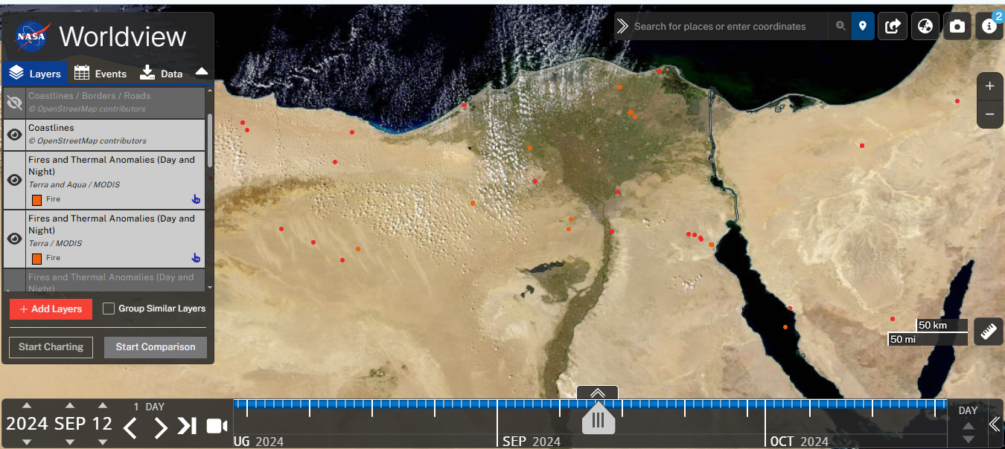
NASA World View
https://worldview.earthdata.nasa.gov/?lg=false&t=2025-08-15-T17%3A10%3A46Z
https://worldview.earthdata.nasa.gov/?v=22.33147620404165,25.999186727110807,37.779579081441014,32.863753671899545&l=Reference_Labels_15m(hidden),Reference_Features_15m(hidden),Coastlines_15m,MODIS_Combined_Thermal_Anomalies_All,VIIRS_NOAA21_CorrectedReflectance_TrueColor(hidden),VIIRS_NOAA20_CorrectedReflectance_TrueColor(hidden),VIIRS_SNPP_CorrectedReflectance_TrueColor(hidden),MODIS_Aqua_CorrectedReflectance_TrueColor(hidden),MODIS_Terra_CorrectedReflectance_TrueColor&lg=false&t=2024-09-12-T17%3A06%3A38Z

Slide 9
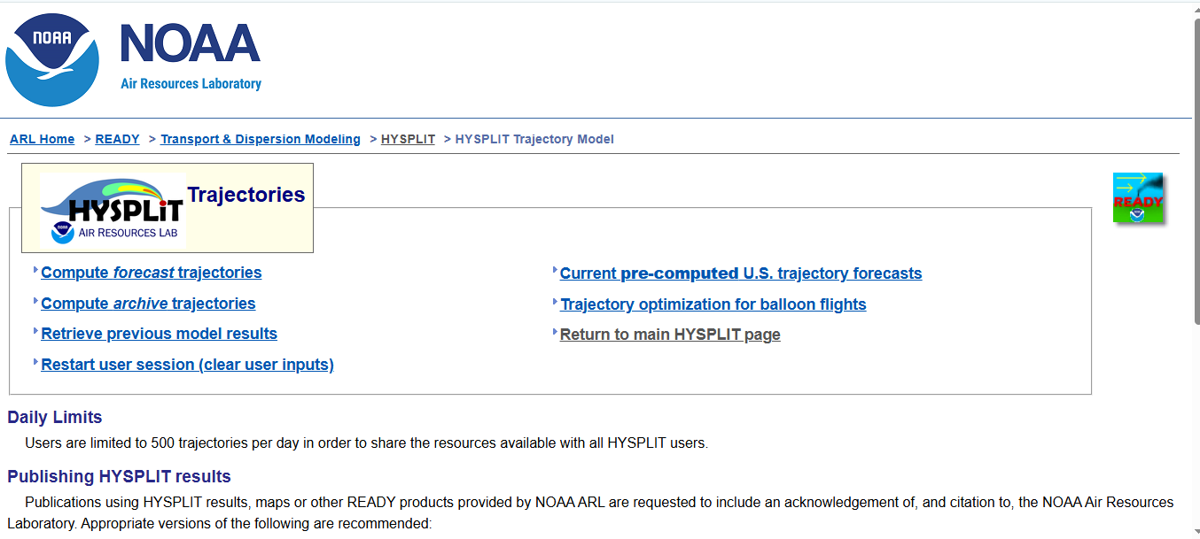
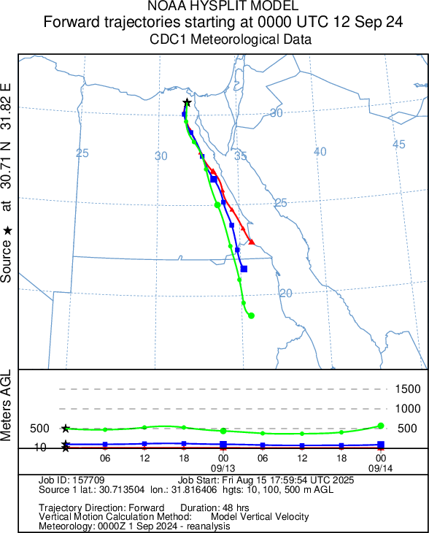
HYSPLIT Trajectory & Dispersion
https://www.ready.noaa.gov/HYSPLIT_traj.php

Slide 10
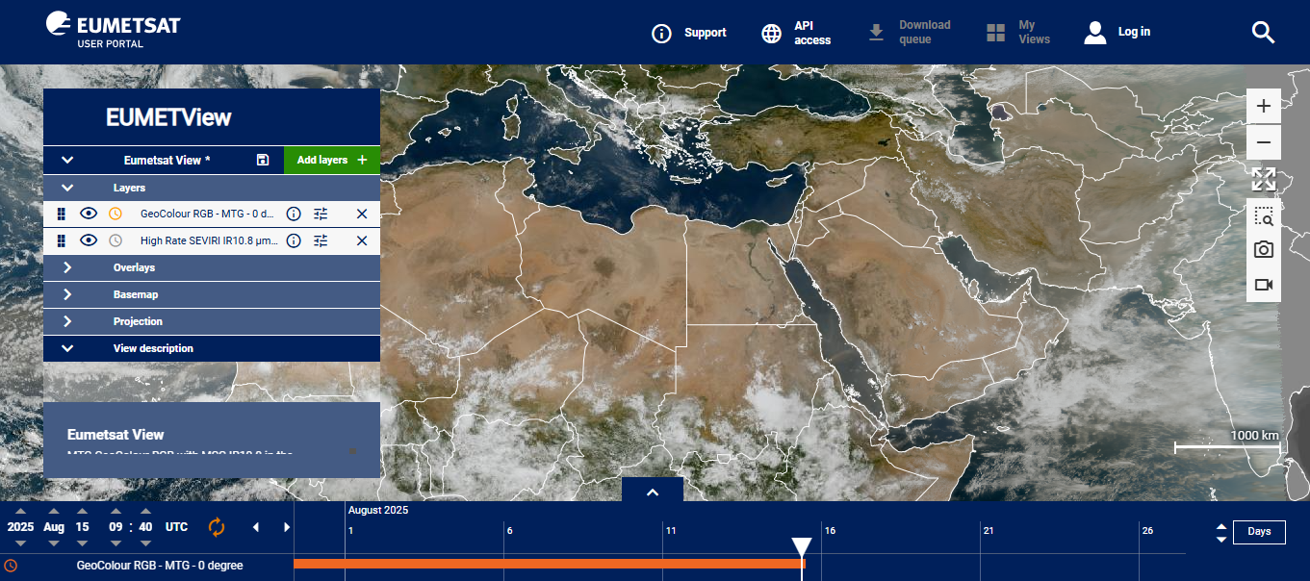
EUMETSAT View
EUMETView is a web-based service provided by the European Organization for the Exploitation of Meteorological Satellites (EUMETSAT) that allows users to visualize and interact with satellite imagery and products. It provides a user-friendly interface for browsing, visualizing, animating, and mapping EUMETSAT data.
https://view.eumetsat.int/productviewer?v=default

Slide 11
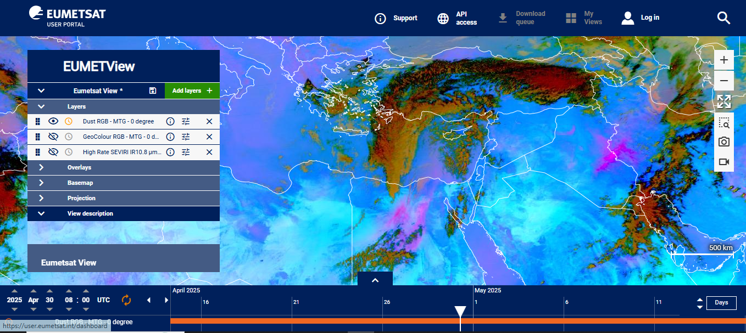
Dust storm detection using EUMETSAT View
clouds
dust
dust

Slide 12
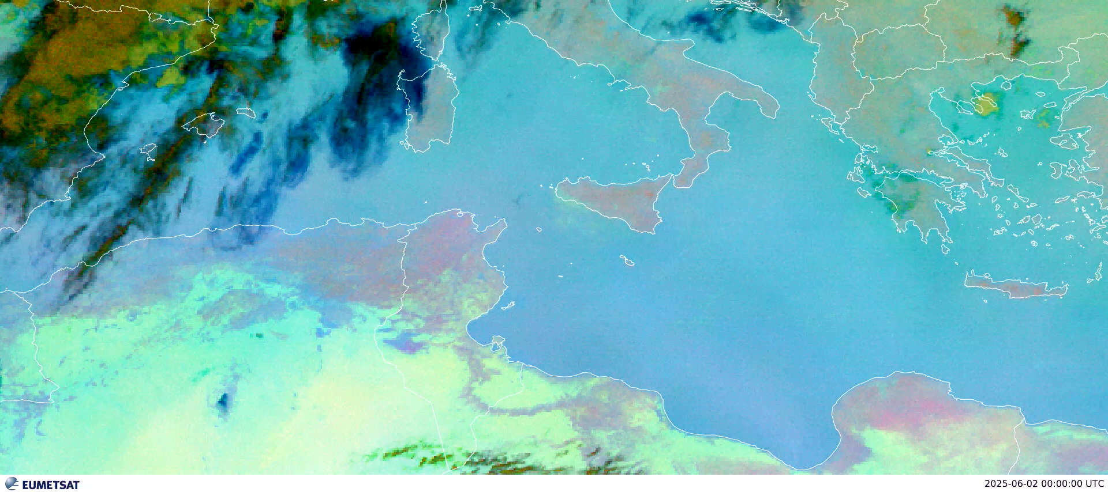
Volcanic Ash detection using EUMETSAT View

Slide 13
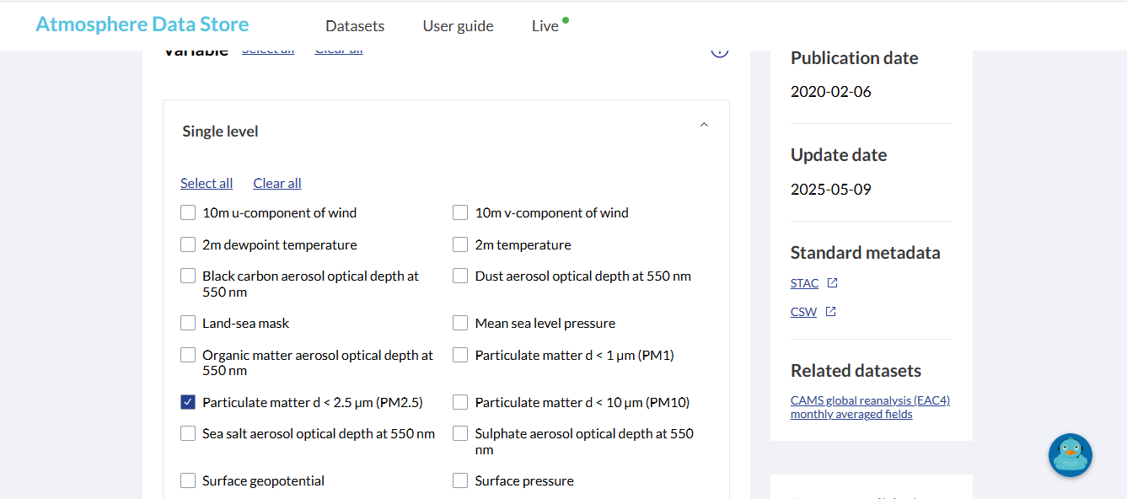
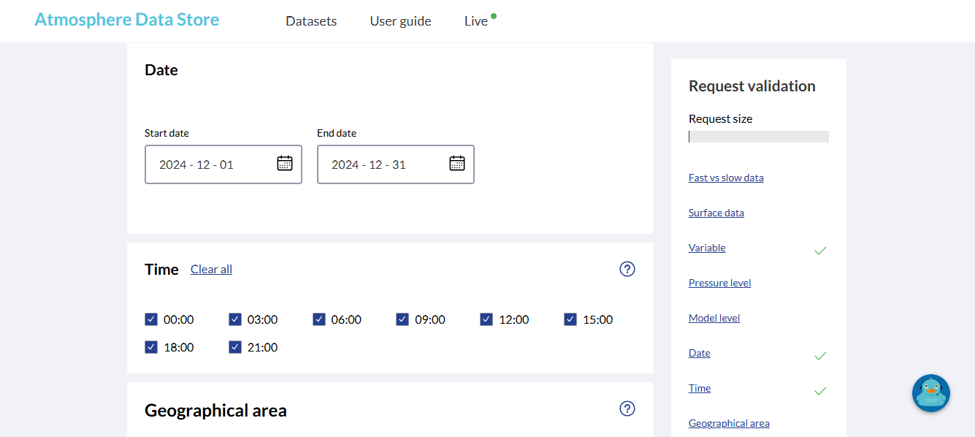
CAMS Global Reanalysis (EAC4)
EAC4 (ECMWF Atmospheric Composition Reanalysis 4) is the fourth generation ECMWF global reanalysis of atmospheric composition.
Reanalysis combines model data with observations from across the world into a globally complete and consistent dataset using a model of the atmosphere based on the laws of physics and chemistry.
https://ads.atmosphere.copernicus.eu/datasets/cams-global-reanalysis-eac4?tab=download

Slide 14
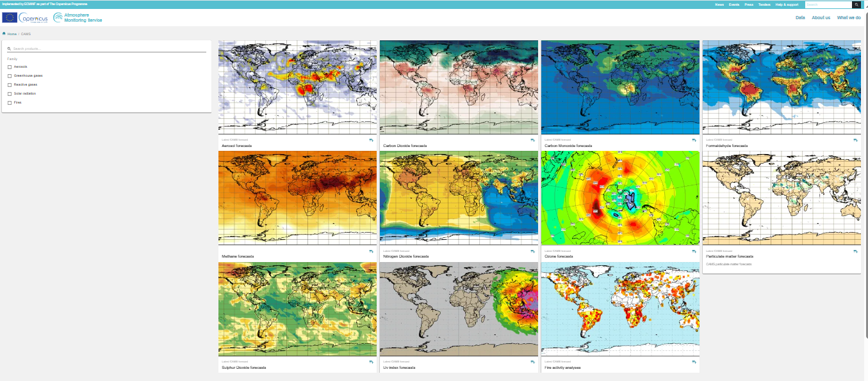
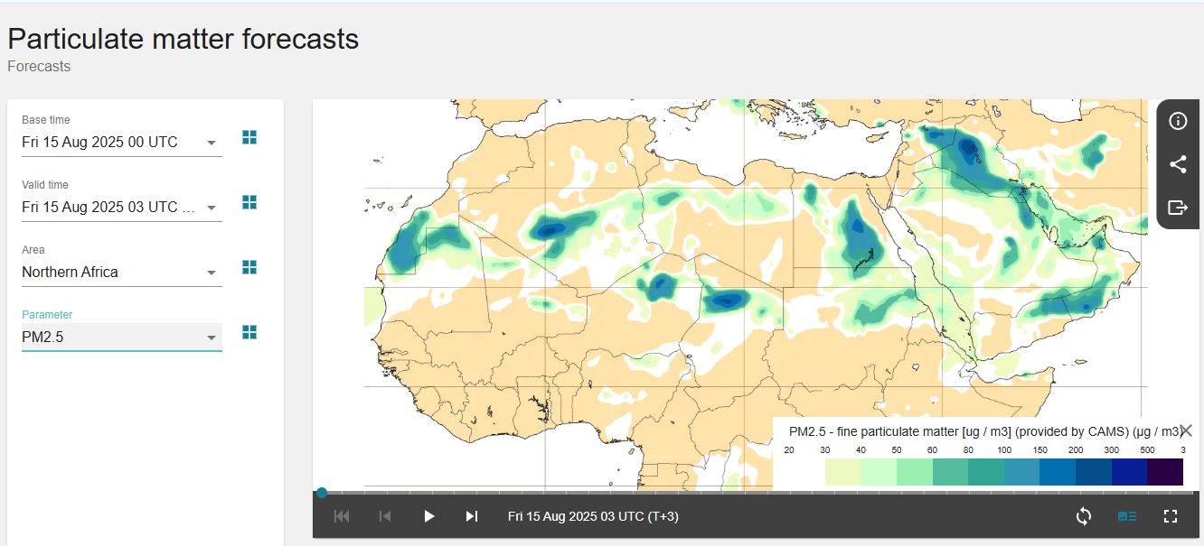
CAMS Global and Regional Forecasts
https://atmosphere.copernicus.eu/charts/packages/cams/

Slide 15


